Slide 1
03/13/2024
LLM Quantization Tijmen Blankevoort Meta

Slide 2
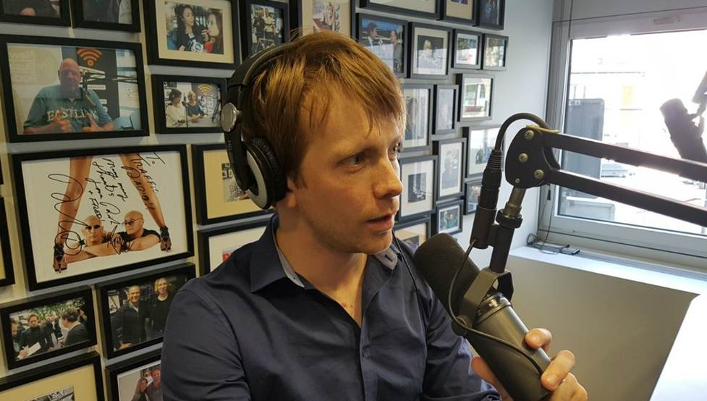
Intro to myself
Tijmen Blankevoort
From the Netherlands
Former CTO co-founder AI startup Scyfer with Max Welling
Former Director of Engineering at Qualcomm
Currently part of Meta - GenAI working on pre-training Llama models
2

Slide 3
LLM-quantization A weight-problem

Slide 4
In this presentation
Equip you with the tools to understand the current SOTA literature on LLM quantization + overview of best techniques
Where do outliers come from?
Rotation/Hadamard matrices and PTQ
KV-cache quantization
Codebooking
(+ Quantized Training?)
Not a focus on results – every method is state-of-the-art and beats the competition :D
What is better when is highly contextual

Slide 5
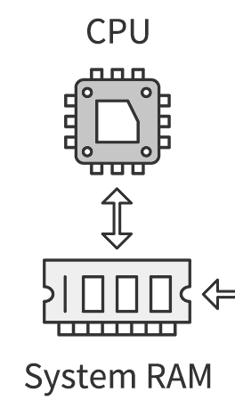
Weights are often what matters in LLM efficiency
In any calculation we:
Move weights/activations to the CPU
Do the calculations
Move the output back
We are either memory transfer bound – or compute bound
For LLM inference we often have:
Small batch-sizes
Little weight re-use
For decode, it’s all matrix-vector products
This means that the biggest bottleneck is often the size of the weights!
But not always…

Slide 6
Where do those outliers come from?

Slide 7
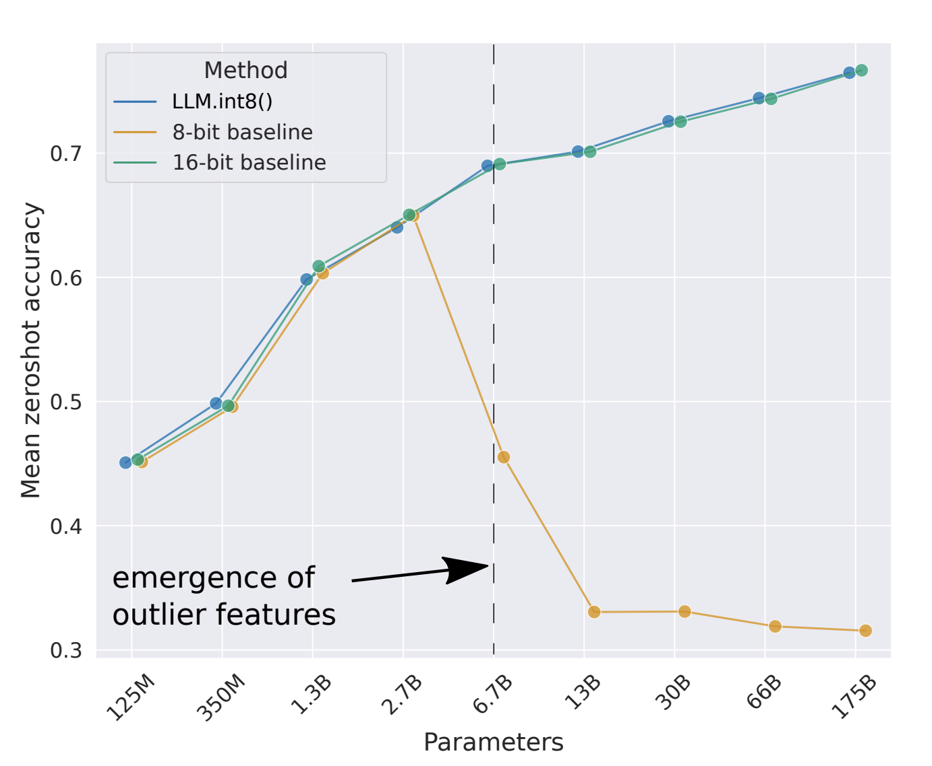
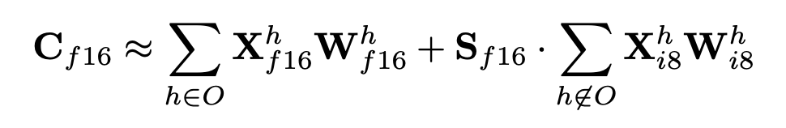
LLM.INT8
One of the first LLM quantization papers – shows the problem of very significant outliers in LLMs
Specifically, the outliers are structured – they are specific to certain channels
This paper solves this with a common trick:
Split the outliers into high-precision sparse matrices
LLM.int8(): 8-bit Matrix Multiplication for Transformers at Scale. Dettmers et al. 2022

Slide 8
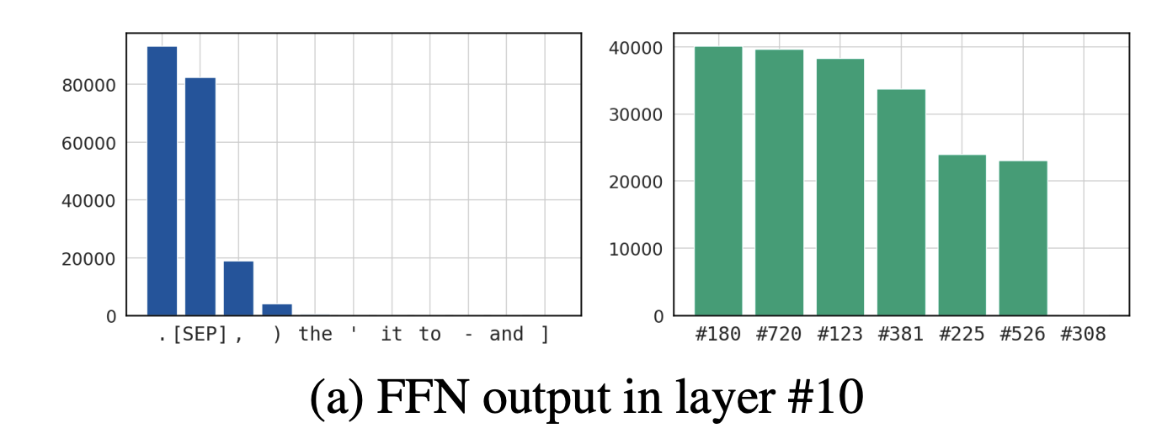
LLM outlier issues

Slide 9
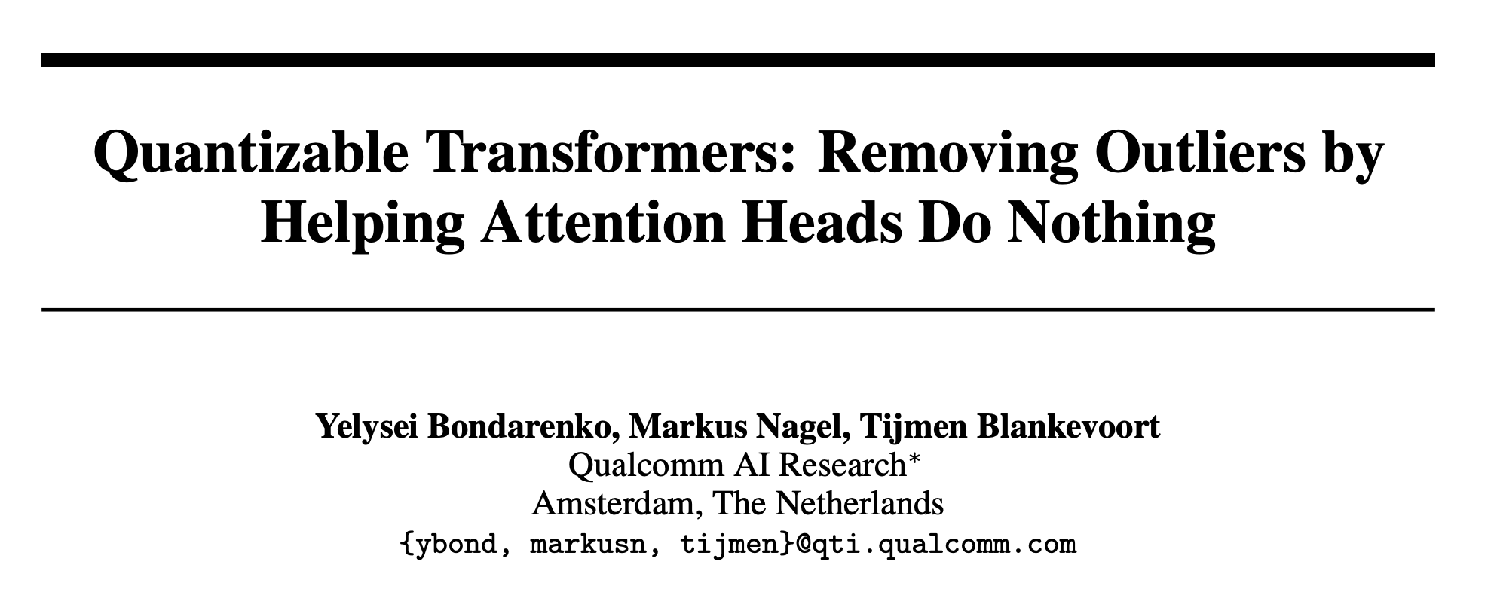

Slide 10
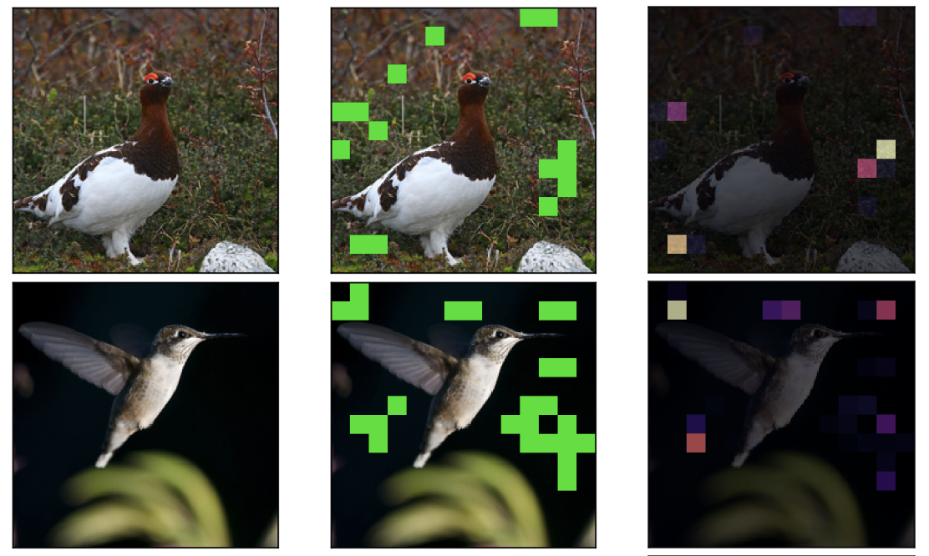
Largest attention tokens

Slide 11
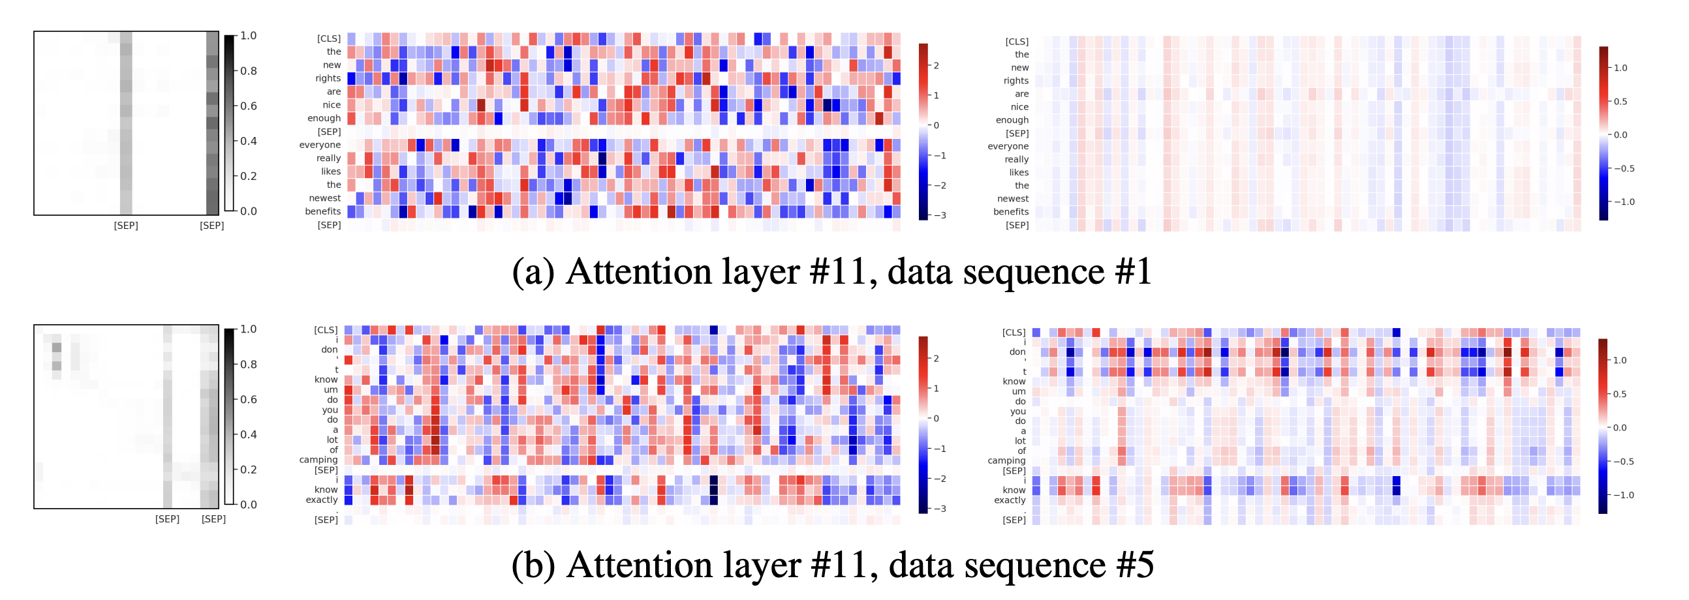
The Block is trying to ‘no-op’

Slide 12
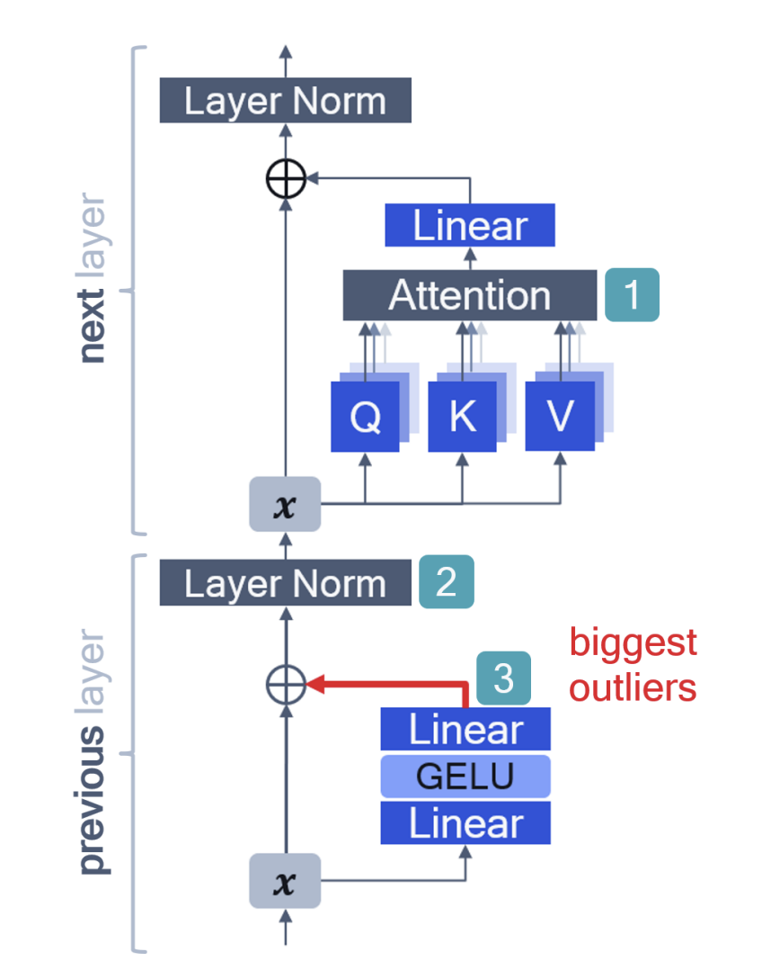
LLM outlier issues
Here is what happens:
The attention [1] needs to represent a no-operation – the residual needs no update
The softmax cannot represent a no-operation
Instead – the network learns to pay full-attention to ‘useless tokens’ that get an infinitesimal value
Limit Attention -> 1 – means some inputs trend to positive/negative infinite
In [2] these inputs are normalized, so the input to the LayerNorm has to become even larger
In order to do so – the previous block outputs extreme outliers, signalling the update is done

Slide 13
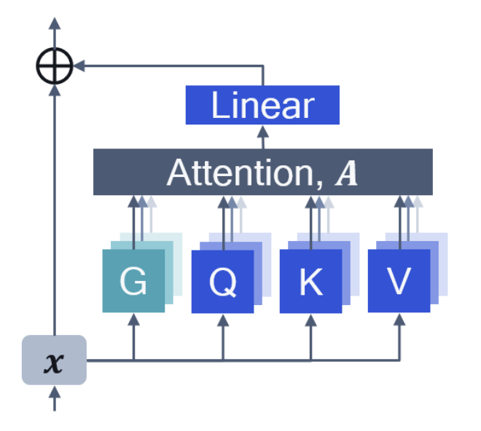
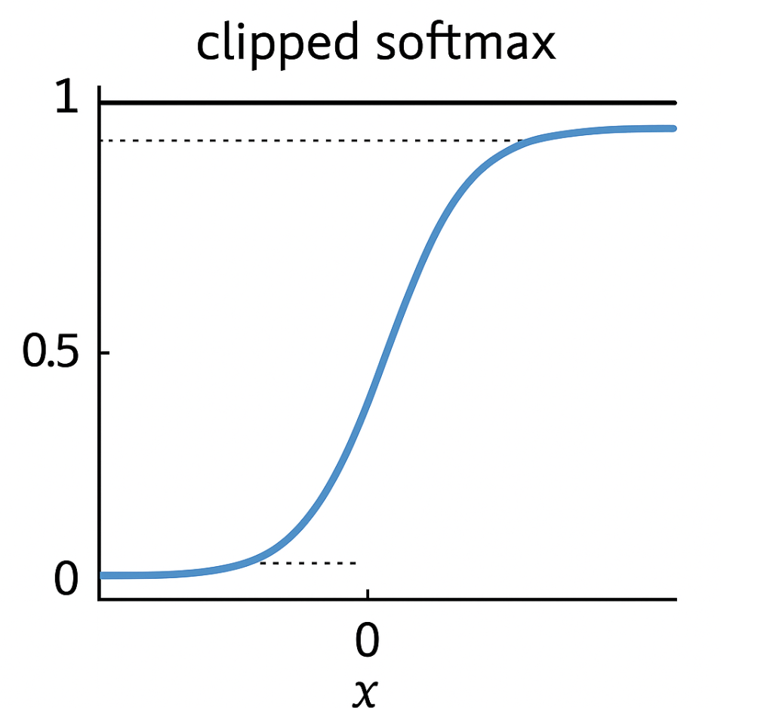
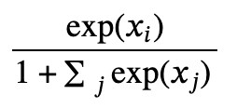
4 fixes
Adding a learnable gate
Clipped softmax
L2
Plus-one Softmax
Regularize the activations

Slide 14
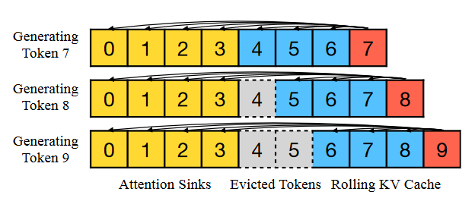
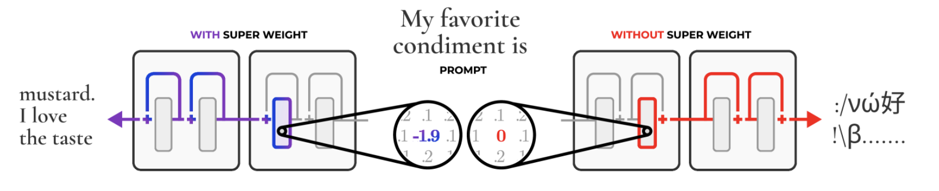
This behavior pops up everywhere
Attention Sinks (Xiao 2023)
Super Weights (Yu 2024)
Almost every time I open LinkedIn, some paper was released that reinvents this -_-’
Efficient Streaming Language Models with Attention Sinks. Xiao et al. 2023
The Super Weight in Large Language Models. Yu et al. 2024

Slide 15
Rotations and Hadamard tricks

Slide 16
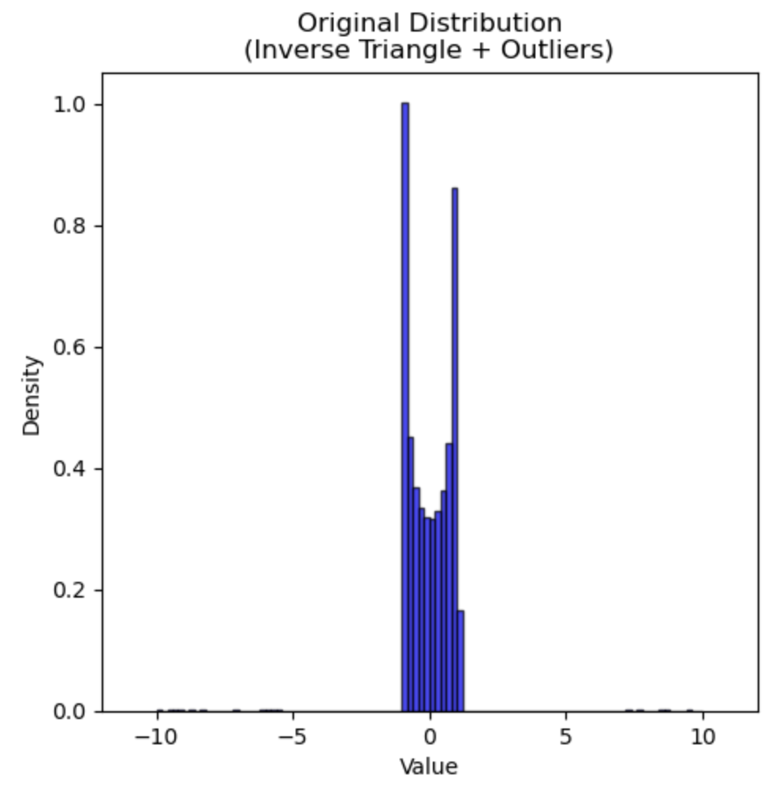
A bad distribution
We take some weight matrix, e.g. a 512x512 matrix
This distribution is quite bad – not Gaussian at all
there are 1% significant outliers
min-max = -10, 10

Slide 17
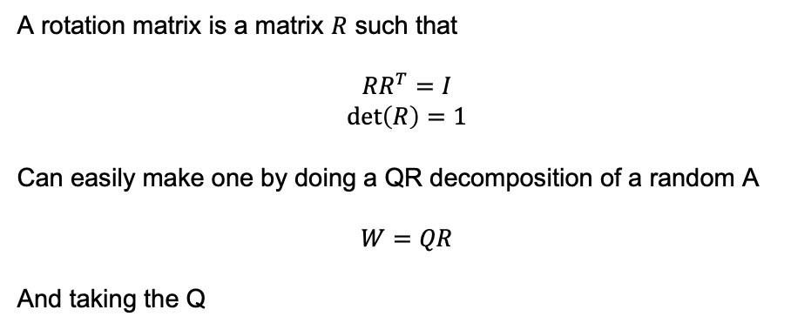
A rotation matrix
A rotation matrix is a matrix $R$ such that
$$RR^{T}=I$$
$$\det\left(R\right)=1$$
Can easily make one by doing a QR decomposition of a random A
$$W=QR$$
And taking the Q

Slide 18
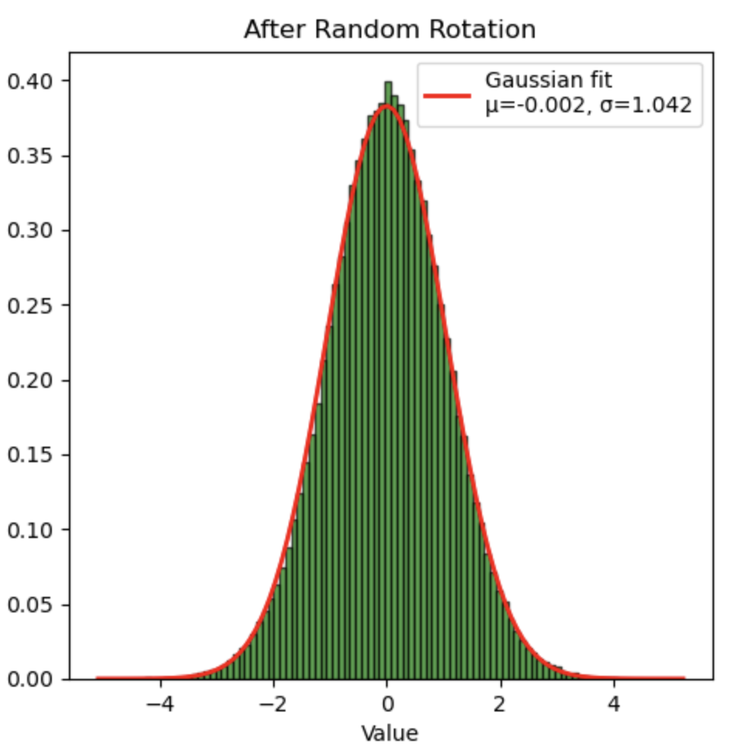
Multiply by R

Slide 19
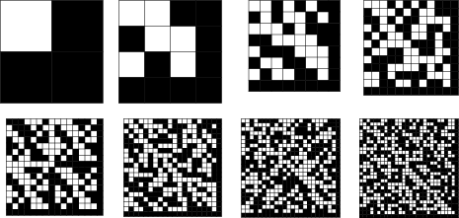
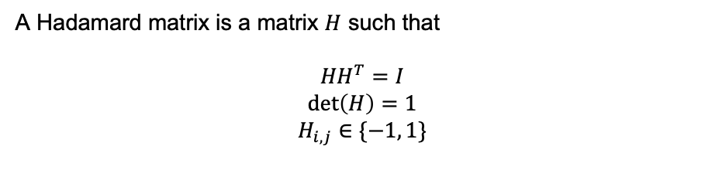
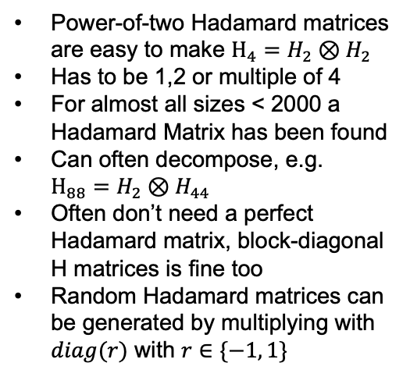
A specific rotation matrix
A Hadamard matrix is a matrix $H$ such that
$${HH}^{T}=I$$
$$\det\left(H\right)=1$$
$$H_{i,j}∈\{−1, 1\}$$
Power-of-two Hadamard matrices are easy to make $H_{4}=H_{2}⊗H_{2}$
Has to be 1,2 or multiple of 4
For almost all sizes < 2000 a Hadamard Matrix has been found
Can often decompose, e.g. $H_{88}=H_{2}⊗H_{44}$
Often don’t need a perfect Hadamard matrix, block-diagonal H matrices is fine too
Random Hadamard matrices can be generated by multiplying with $diag(r)$ with $r∈\{−1, 1\}$

Slide 20
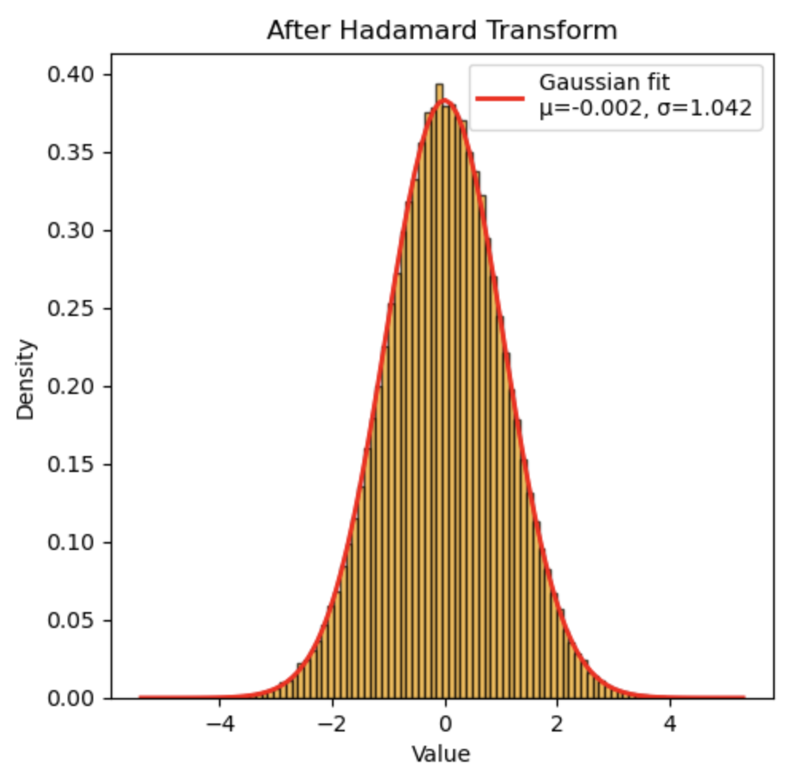
Hadamard transforms have nice properties

Slide 21
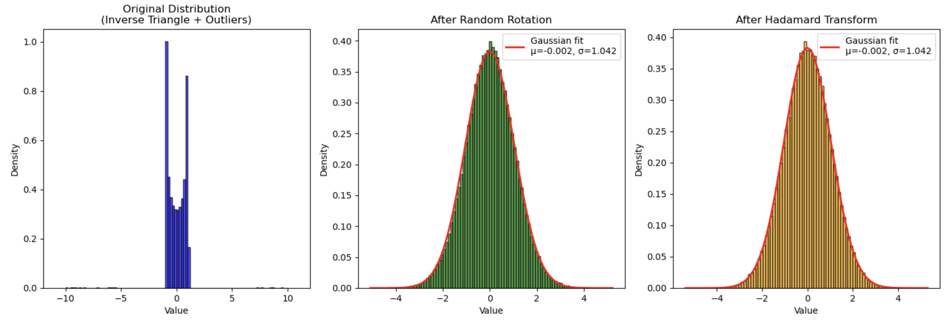
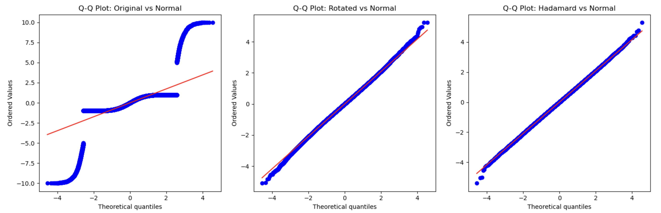
Hadamard transforms have nice properties
After the Hadamard transform – the distribution is even more Gaussian!
Shapiro-Wilk Normality Test (p-values): Original: 0.000000 Rotated: 0.000399 Hadamard: 0.252362
Kurtosis:
Original: 30.981354 Rotation: 0.196846 Hadamard: 0.058192

Slide 22
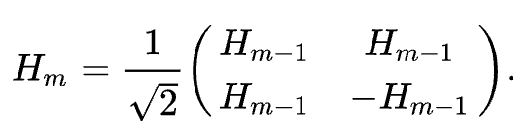
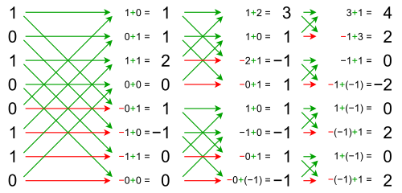
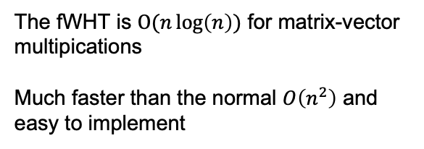
The fast Walsh-Hadamard transform
Recursive definition based on:
The fWHT is $O(n\log\left(n\right))$ for matrix-vector multipications
Much faster than the normal $O\left(n^{2}\right)$ and easy to implement

Slide 23
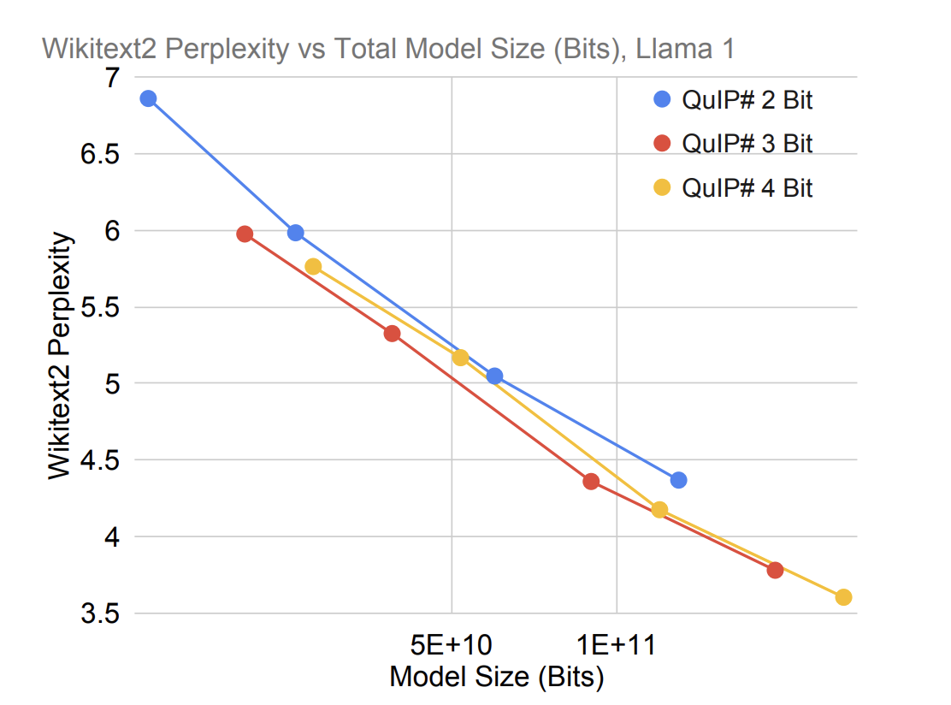
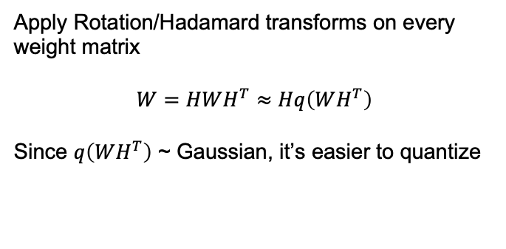
QUIP / QUIP#
Apply Rotation/Hadamard transforms on every weight matrix
$$W=HWH^{T}≈Hq\left(WH^{T}\right)$$
Since $q\left(WH^{T}\right)$ ~ Gaussian, it’s easier to quantize
Downside:
You still have to do all the Hadamard matrix multiplications inside the network
The gains from lower-bit quantization are diminished by the extra transform for each linear operation.
QUIP(#) uses this to quantize networks to 2-4 bits – with E8-lattice codebooks + local fine-tuning
QuIP: 2-Bit Quantization of Large models with Guarantees. Chee et al. 2024
QuIP#: Even Better LLM Quantization with Hadamard Incoherence and Lattice Codebooks. Tseng et al. 2024

Slide 24
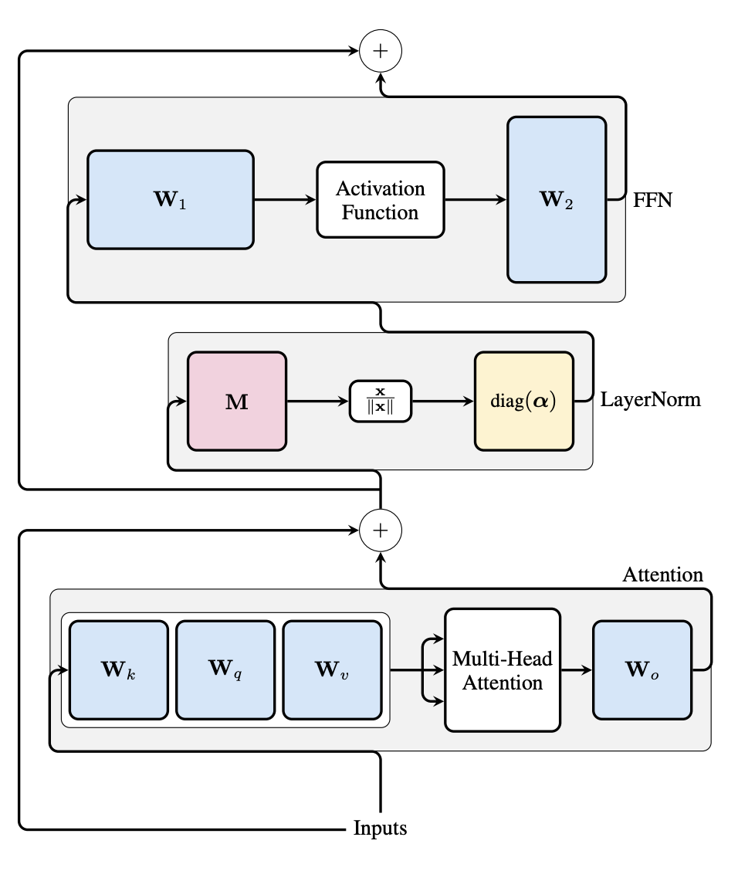
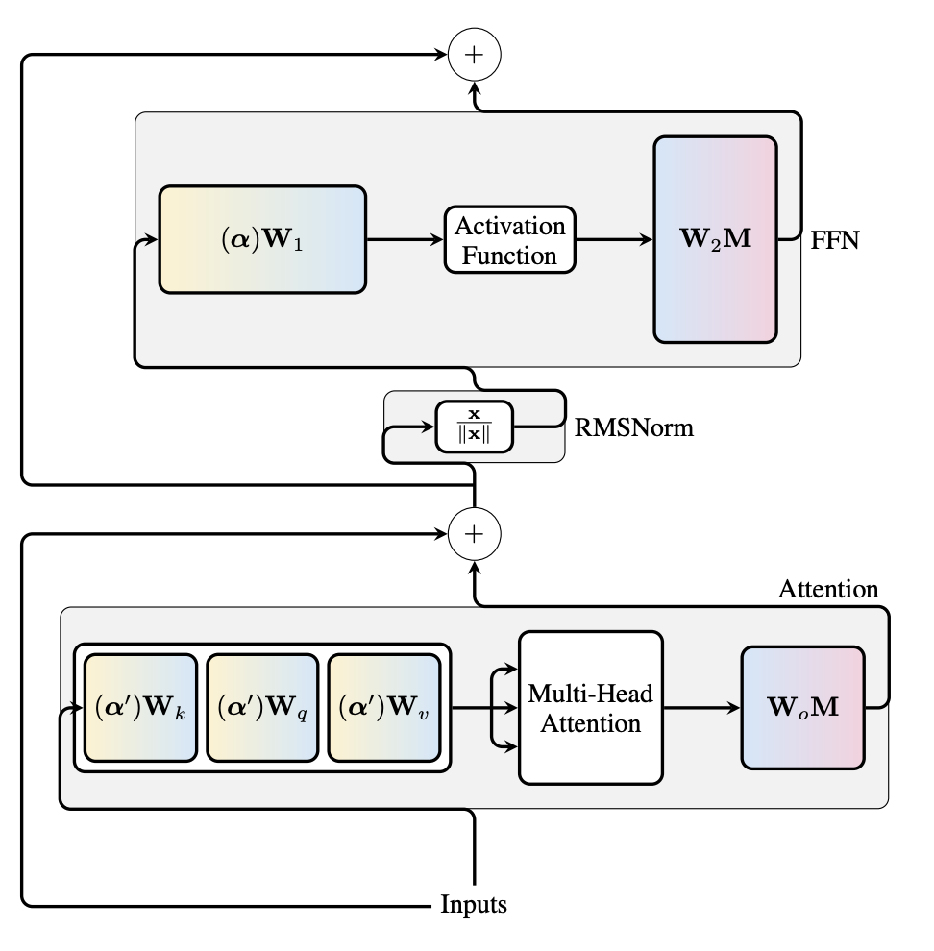
SliceGPT – LayerNorm -> RMSNorm
SliceGPT: Compress Large Language Models by Deleting Rows and Columns. Ashkboos et al. 2024

Slide 25
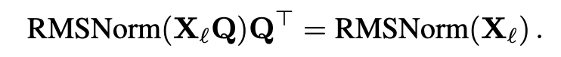

SliceGPT – LayerNorm -> RMSNorm
With $Q$ a Rotation matrix
SliceGPT: Compress Large Language Models by Deleting Rows and Columns. Ashkboos et al. 2024

Slide 26
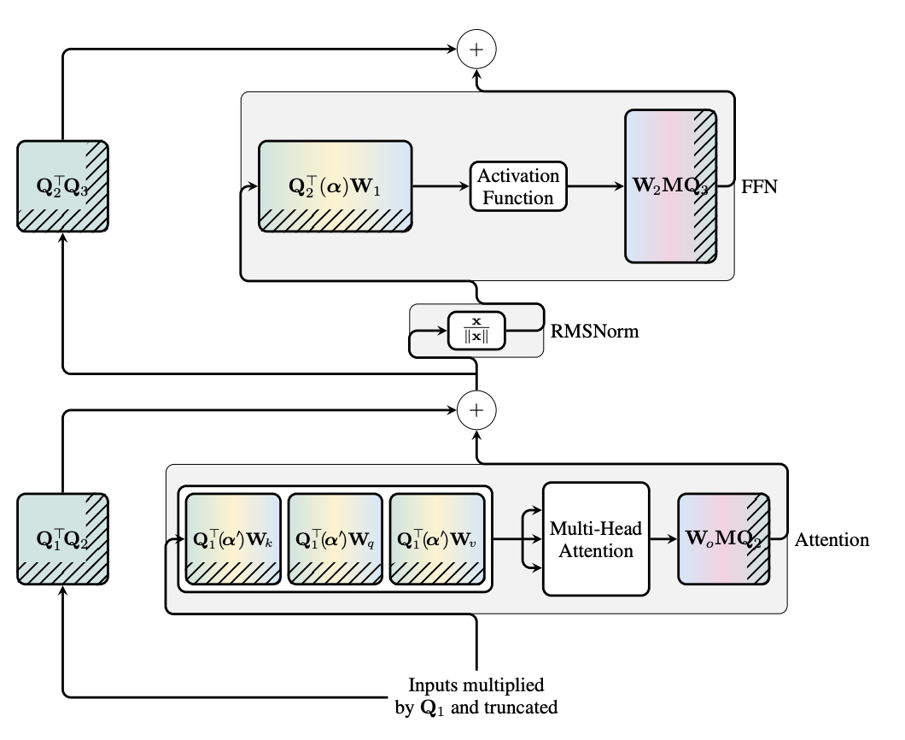
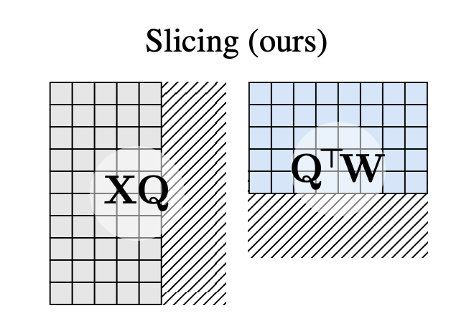
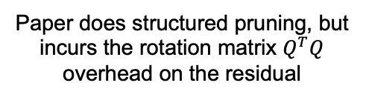
SliceGPT – Rotations on residuals
Paper does structured pruning, but incurs the rotation matrix $Q^{T}Q$ overhead on the residual
SliceGPT: Compress Large Language Models by Deleting Rows and Columns. Ashkboos et al. 2024

Slide 27
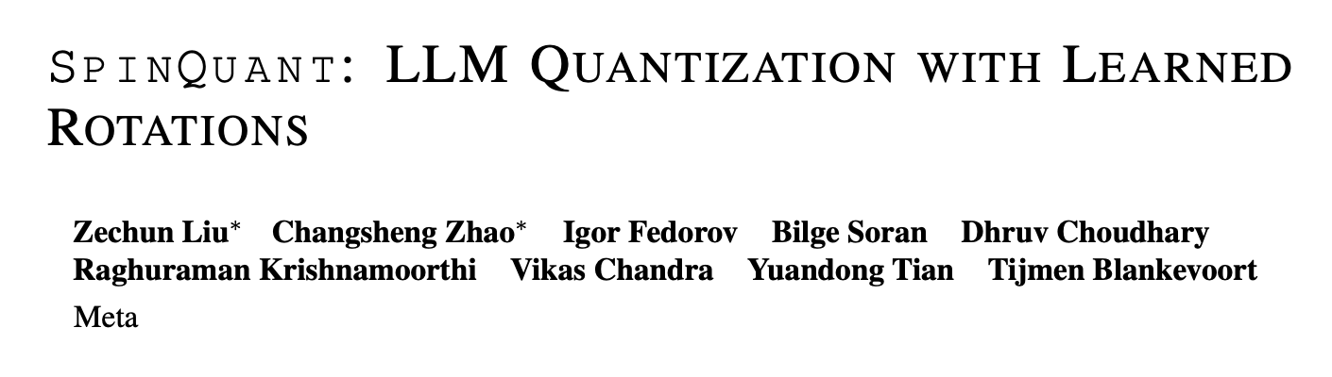
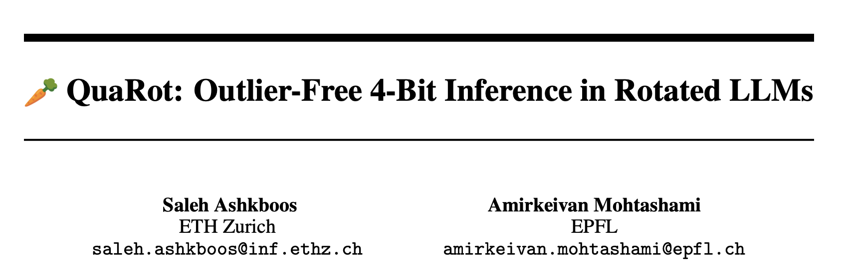

Slide 28
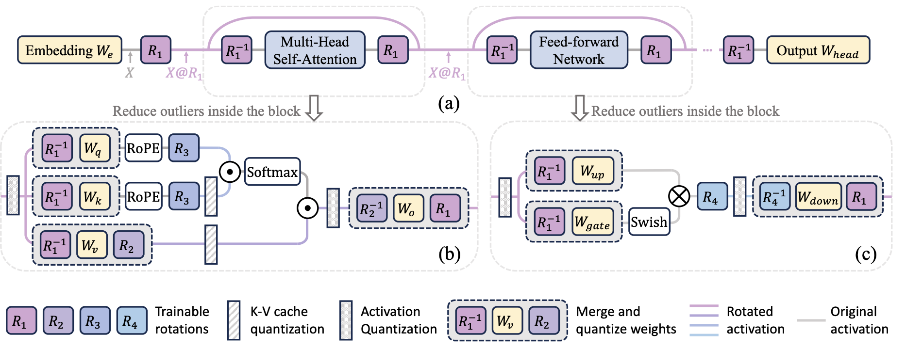
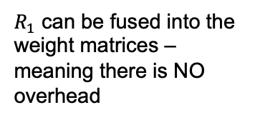
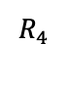
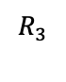
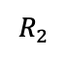
SpinQuant/Quarot
$R_{1}$ can be fused into the weight matrices – meaning there is NO overhead
We can repeat this trick in multiple places
$$R_{2}$$
Can also be fused
$$R_{3}$$
No fusing - Hadamard
$$R_{4}$$
No fusing – Hadamard

Slide 29
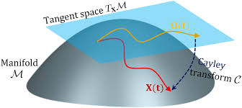
SpinQuant – Optimizing rotation matrices
With a Rotation/Hadamard transformation - outliers can still persist and hurt perfomance
We can optimize rotation matrices with back-propagation – by using a Caley Transformation
Only slight tuning is needed!

Slide 30
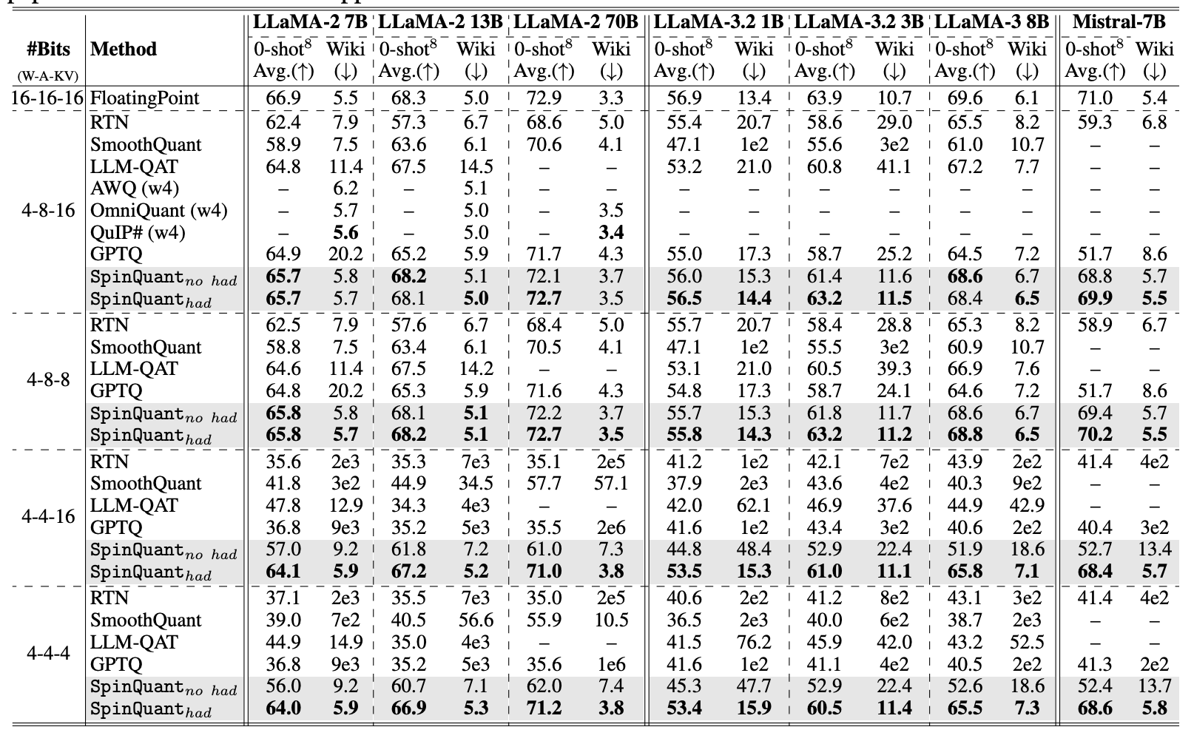
SpinQuant Results

Slide 31
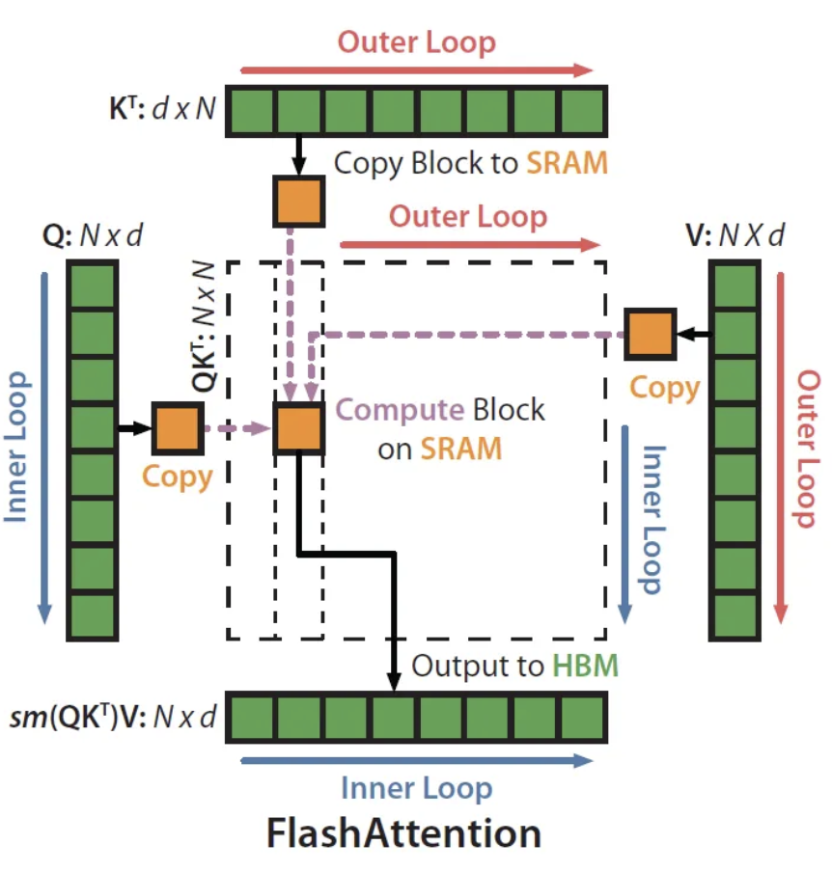
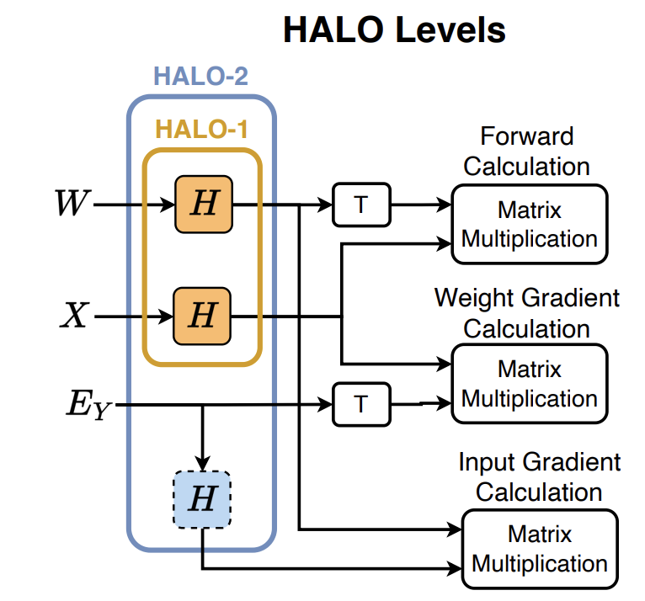
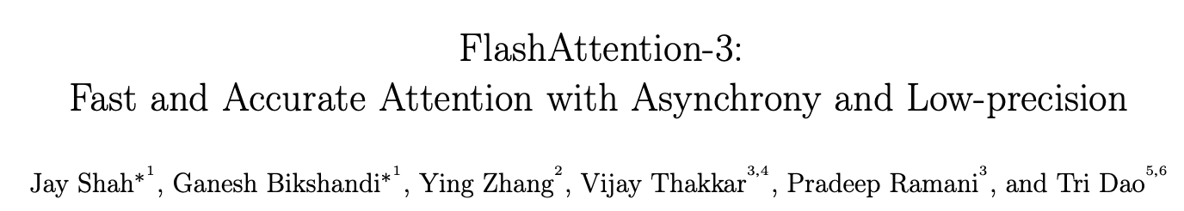
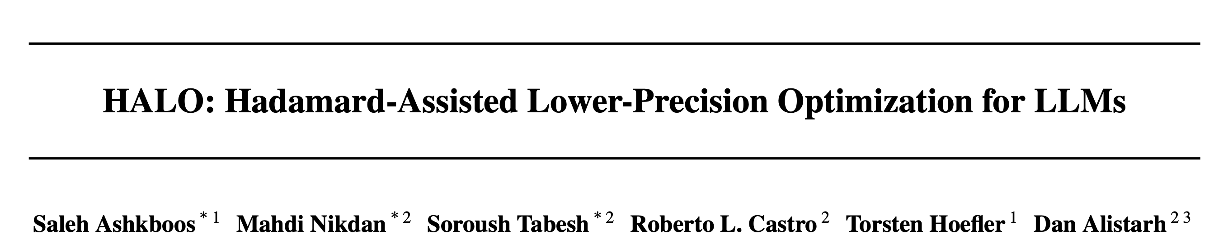
Widespread usage of the Hadamard Transform

Slide 32
KV-cache quantization

Slide 33
KV-cache quantization
The KV-cache is usually not a huge bottleneck…
Until you get to very large context lengths – then it becomes dominant!
At this point, kv-cache transfer becomes the bottleneck – similar to weight quantization – we can trade off storage for compute with e.g. codebooking
33

Slide 34
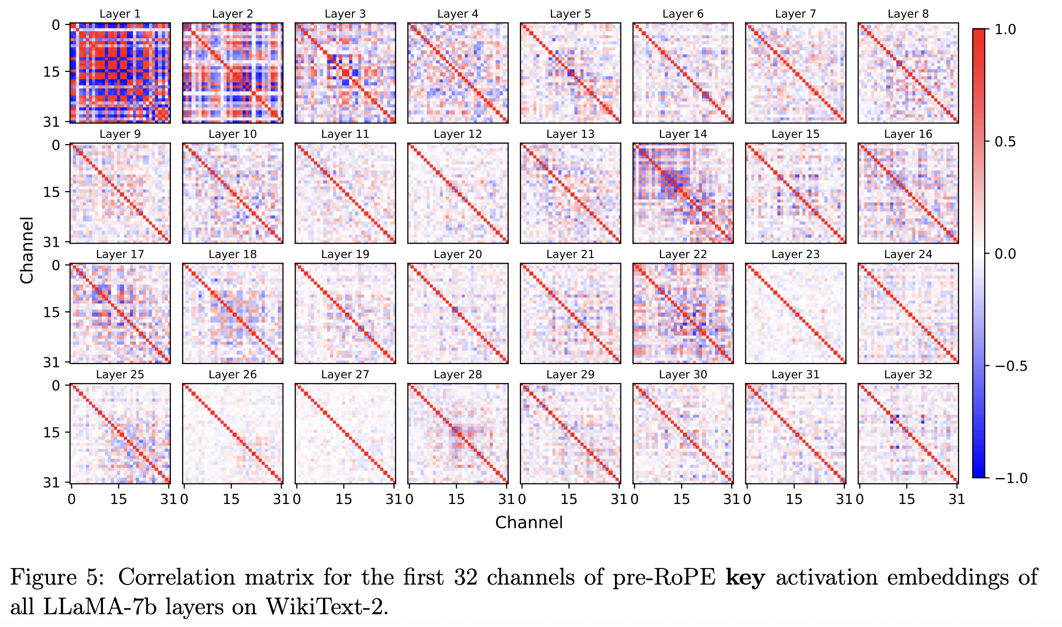
KV-cache quantization – correlations
34
KV Cache is 1 Bit Per Channel: Efficient Large Language Model Inference with Coupled Quantization. Zhang et al. 2024

Slide 35
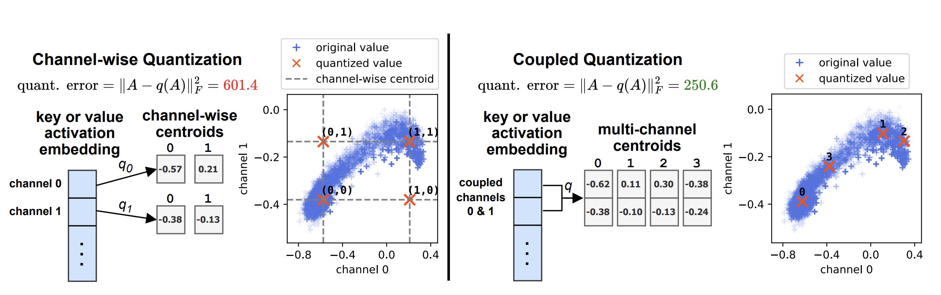
KV-cache quantization – Codebooks work well
35
KV Cache is 1 Bit Per Channel: Efficient Large Language Model Inference with Coupled Quantization. Zhang et al. 2024

Slide 36
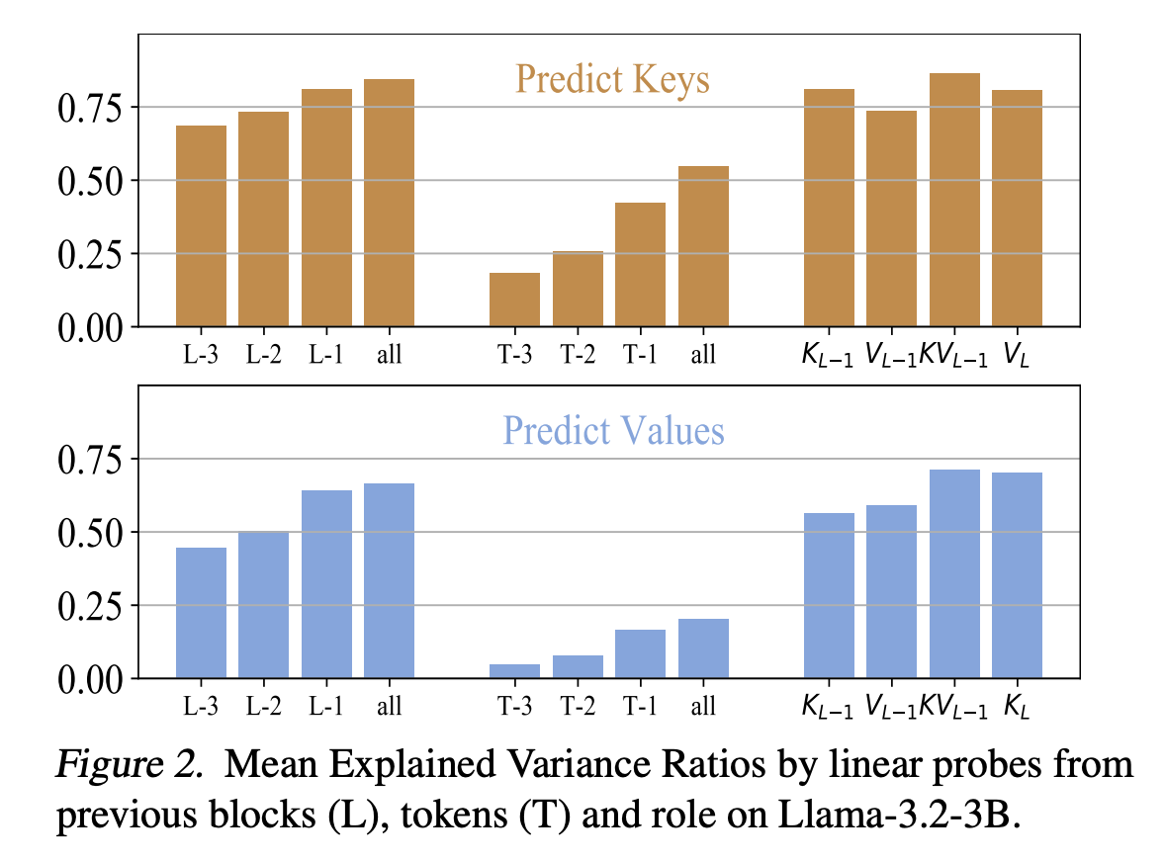
KV-cache quantization
K-cache 1
K-cache 2
V-cache 1
V-cache 2
Layer 1
Layer 2
Are the cross-layer or cross K-V correlations?
Cache Me If you Must: Adaptive Key-Value Quantization for Large Language Models. Shutova et al. 2024

Slide 37


KV-cache quantization
Cache Me If you Must: Adaptive Key-Value Quantization for Large Language Models. Shutova et al. 2024

Slide 38
QAT improvements

Slide 39

QLoRA
Makes fine-tuning more efficient by:
Fine-tuning with LoRA with base-model quatized to 4 bits
Quantizing the scale factors
NormalFloat Format
But:
The resulting model is not itself quantized – as the adapters + original weights are not together quantized
LoRA as a parameter-efficient fine-tuning (PEFT) method
QLoRA: Efficient Fine-tuning of Quantized LLMs: Dettmers et al. 2023

Slide 40


Low-Rank Quantization-Aware Training for LLMs
LoRA, but within the quantizer
The resulting model is quantized!
Low-Rank Quantization-Aware Training for LLMs. Bondarenko et al. 2024

Slide 41
ParetoQ

Slide 42
$$X W_{INT8}=XW_{INT4_{MSB}}+XW_{INT4_{LSB}}$$
INT8
INT4
What bit-width is optimal?

Slide 43


Other works
Is 4-bit optimal?
Perhaps Ternary is where it’s at?

Slide 44

Other works
Wait, or is it 8 bits?

Slide 45

What is the optimal bit-width if we do proper quantization-aware training?

Slide 46


More optimal QAT for lower bit-widths
Don’t train from scratch - fine-tune in the last phase!
Longer fine-tuning needed for lower bit-widths

Slide 47

More optimal QAT for lower bit-widths
Learning the quantization ranges during training is more vital for low bit-width QAT
Centralized low-bit schemes without 0 perform better

Slide 48

ParetoQ

Slide 49

ParetoQ

Slide 50

Quest
Similar conclusion with different QAT approach
Quest: Stable Training of LLMs with 1-Bit Weights and Activations. Panferov et al. 2025

Slide 51

Quest
When quantizing activations w3a3 or w4a4 is optimal?
Quest: Stable Training of LLMs with 1-Bit Weights and Activations. Panferov et al. 2025

Slide 52



Quest - Forward
Hadamard transformation of the weights activations in the forward pass
Once Gaussian – you can do ‘optimal clipping’ to determine the min-max
Quest: Stable Training of LLMs with 1-Bit Weights and Activations. Panferov et al. 2025

Slide 53



Quest - Backward
Don’t update the weights with strongly clipped gradients.
(but in the Hadamard domain)
Quest: Stable Training of LLMs with 1-Bit Weights and Activations. Panferov et al. 2025

Slide 54
Conclusions
To do proper low-bit training, a bit more work is needed: proper range-setting, proper schedules, correct formats and good initialization
For weight quantization 2-3 bits is likely optimal with proper training
For weight+activation quantization w4a4 seems more pareto optimal
In the future – We should see our GPUs natively support low-bit formats
Quest: Stable Training of LLMs with 1-Bit Weights and Activations. Panferov et al. 2025

Slide 55
Codebooking

Slide 56


Codebooking
A codebook $C∈ℝ^{MxN}$ has $M$ centroids of dimensionality $N$
Think of it as a dictionary where we can look up vectors called centroids
We can then express any weight matrix as
$$W≈C[W_{int}]$$
Where $W_{int}$ are now indices to look up corresponding values in the codebook
We store $C$ and $W_{int}$
And make sure the size of both is smaller than the original weight size.
Then we have less memory transfer, but with extra overhead with the look-up
GPTVQ: The Blessing of dimensionality for LLM quantization. Van Baalen et al. 2024

Slide 57

Codebooking
You can fit centroids to a distribution to fit it better
This is an example of NormalFloat4 that better captures Gaussians
With codebooking, you can put the representable quantization points ANYWHERE on the grid – meaning you can fit any distribution better!
We can theoretically capture any numeric format this way!
QLoRA: Efficient Fine-tuning of Quantized LLMs: Dettmers et al. 2023

Slide 58


Vector Quantization
Vector or Product quantization does codebooking with higher dimensions
GPTVQ: The Blessing of dimensionality for LLM quantization. Van Baalen et al. 2024

Slide 59

Lattices
An example of the E8 lattice – trying to pack a sphere as best as possible
(Also used in string theory :p)
These methods essentially add some structure to get similar expressiveness as a codebook at a lower cost
QuIP#: Even Better LLM Quantization with Hadamard Incoherence and Lattice Codebooks. Tseng et al. 2024

Slide 60

Lattices
Another example from Pyramid Vector Quantization – This can also be applied to activations since casting/converting is relatively cheap
Pyramid Vector Quantization for LLMs. Van den Ouderaa et al. 2024

Slide 61
Trade-off in complexity/accuracy
Complexity: INT > Exponent bits (float) > Lattices > Codebook > Codebook per group
Accuracy: INT < Exponent bits (float) < Lattices < Codebook < codebook per group

Slide 62


AQLM
AQLM uses additive codebooks to great effect
The local MSE can be used to optimize the codebooks and assignments. E.g. by beam-search for the indices.
The codebook can be trained like a normal weight.
Also apply light fine-tuning to the centroids with codes fixed
Extreme compression of Large Language models via Additivite Quantization. Egiazarian et al. 2024

Slide 63

Codebooking at inference time
GPTVQ: The Blessing of dimensionality for LLM quantization. Van Baalen et al. 2024

Slide 64


Codebooking at inference time - FLUTE
Fast GPU implementations like FLUTE optimize the GPU kernels for these lookups with complex cache management
For small tensors the overhead is negligible – but for larger tensors this is always theoretically slower than just INT/FP
Fast Matrix multiplications for Lookup Table-Quantized LLMs. Guo et al. 2024

Slide 65
Quantized Training Training in lower-bits

Slide 66

FP8
Mixed-precision training with 8-bit floating point. Mellempudi et al. 2019

Slide 67
Hadamard in the backward pass
Mixed-precision training with 8-bit floating point. Mellempudi et al. 2019

Slide 68


MXFP4 training - Quartet
Improving Quantized Training, they find:
Forward pass: reduce MSE by using Hadamard/Quest
Backward pass: Reduce bias by stochastic rounding
+ Fast fused kernels
Quartet: Native FP4 Training Can Be Optimal for Large Language Models. Castro et al. 2025

Slide 69
Mixed precision

Slide 70
Quantization frameworks

Slide 71
Conclusions
PTQ SOTA:
MSE-range setting
SpinQuant/AdaRound
GPTQ
4-bit weights (and activations) are easy to achieve
KV-cache quantization
Can get to 2 bits without significant degradation
QAT
With a proper setup, 2 bit might give the most optimal network size/performance trade-off
Quantized Training
Applying Hadamard transforms on the gradients allows for quantized gradient multiplications too
MXFP4 format might give better training time/performance trade-offs

Slide 72
Day/Month/Year
Thank you.

